Slide 1
Hadoop-GIS: A High Performance Spatial Data Warehousing System over MapReduce
Presented by:
Thoshita Movva
Pradeepika Kolluru
Sindhusha Tiyyagura
Sravan Kumar Pagadala
Goutham Gandreddi

Slide 2
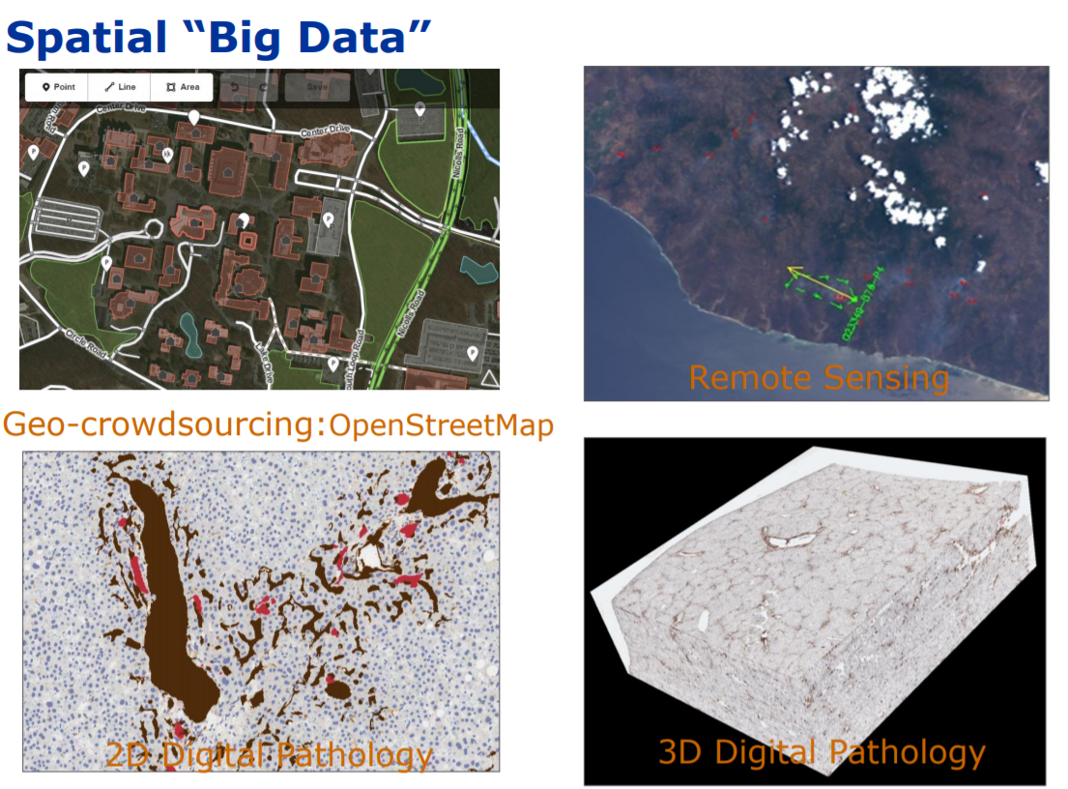
Source: https://www.google.com/search?q=spatial+big

Slide 3
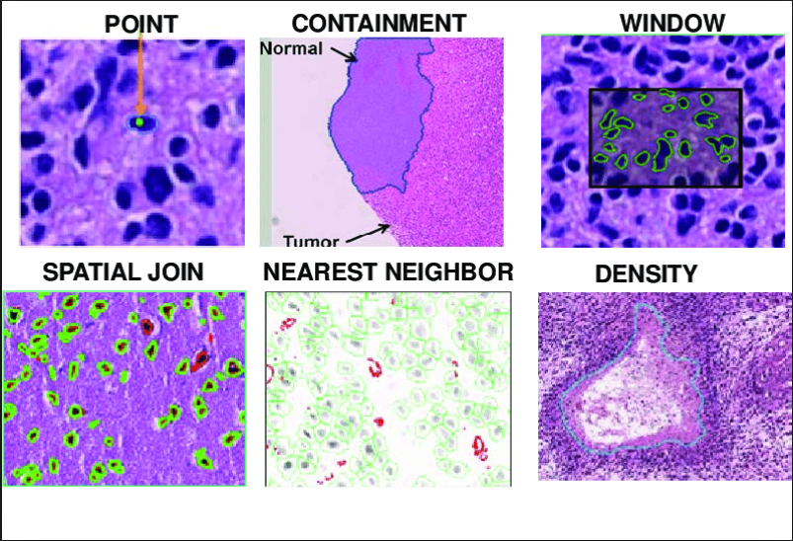
REAL TIME EXAMPLES:
DIGITAL PATHOLOGY IMAGING:
Source: https://ktn-uk.co.uk/news/creating-a-network-of-digital-pathology- imaging-and-ai-centres

Slide 4

DIGITAL PATHOLOGY IMAGING:
Source: https://ktn-uk.co.uk/news/creating-a-network-of-digital-pathology- imaging-and-ai-centres

Slide 5
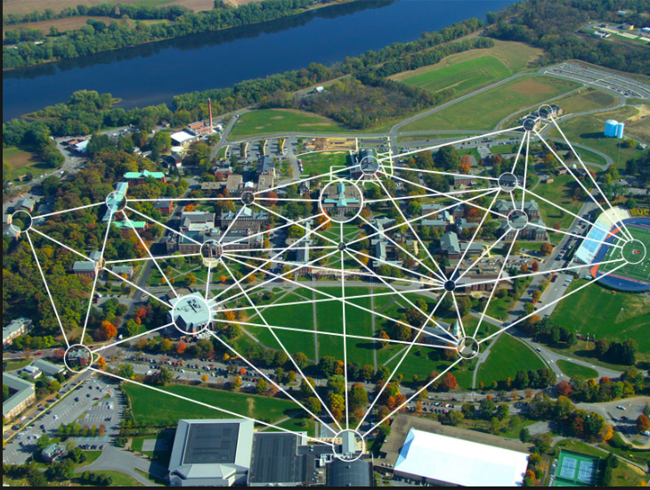
LOCATION BASED SOCIAL NETWORKS:
Source: https://www.google.com/search?q=location+based+social+network&rl

Slide 6
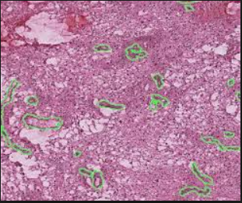
BIOMEDICAL APPLICATIONS:
Fig: High Performance spatial query system for Large scale spatial imaging data
Source:https://www.google.com/search?rlzHigh+Performance+spatial+query+ system+for+Large+scale+spatial

Slide 7
CHALLENGES OF MODERN SPATIAL APPLICATIONS:
BIG DATA CHALLENGE:
Moderate size hospital can routinely generate thousands of whole slide images per day.
Open street map project has more than 600,000 contributors & user contributing data is increasing continuously.
HIGH COMPUTATION COMPLEXITY:
Multi-Dimensional and involves heavy duty geometric computations.
Spatial join queries like spatial cross-matching and overlaying multiple sets of spatial objects on an image or map is very expensive.

Slide 8
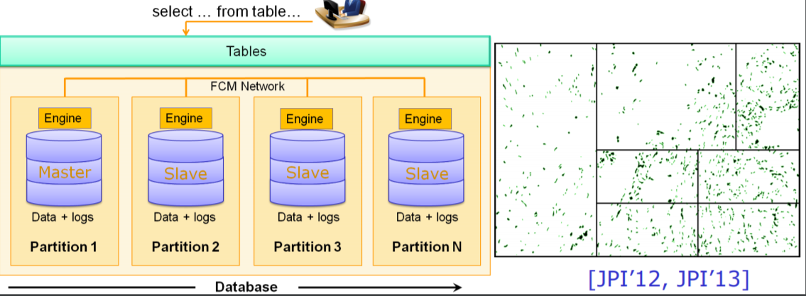
TRADITIONAL METHODS FOR SPATIAL QUERIES:
Parallel SDBMS :
A potential approach for scaling out spatial queries.
Architecture through partitioning to increase I/O bandwidth via parallel data access.
Source: https://www.google.com/search?rlz=parallel+SDBMS+&oq

Slide 9
TRADITIONAL METHODS FOR SPATIAL QUERIES:
Advantages:
Comprehensive model and expressive query language for modeling and querying spatial data.
Scale out is possible.
Limitations:
Lacks Spatial partitioning mechanism to balance data and task loads.
High data loading overhead
Highly expensive on Software licensing
Requires sophisticated tuning and maintenance efforts.

Slide 10
MAP REDUCE:
It is a scalable and cost effective solution for massively parallel processing.
Hive, Pig and Scope have brought the large scale data analysis one step closer to common users by providing high level, developer friendly programming abstractions to MapReduce.
Hive is adopted as a scalable data warehousing solution in many enterprises including Facebook.

Slide 11
PROBLEMS FOR SPATIAL PARTITIONING:
MapReduce has limited query support.
Spatial Data Skew Problem:
Load imbalance of tasks & Long response time.
Boundary Object Problem:
Incorrect query results if not handled properly.

Slide 12
GOAL: HIGH PERFORMANCE SPATIAL QUERIES AND ANALYTICS
Hadoop GIS (Geographic Information System) is a scalable and high performance spatial data warehousing system for running large scale spatial queries on Hadoop.
To deliver Scalable, efficient, expressive spatial querying system to support analytical queries on large scale spatial data.
It also provides Spatial Query Language (SQL) for workload specification.

Slide 13
OVERVIEW:
QUERY CASES:
Feature aggregation queries
Fundamental spatial queries
Complex spatial queries
Integrated spatial and feature queries
Global spatial pattern queries

Slide 14
OVERVIEW OF METHODS:
Workflow of spatial query processing on MapReduce:
Data/Space partitioning
Data Storage of partitioned data on HDFS
Pre-query processing
Tile based spatial query processing
Boundary object handling
Post-query processing
Data aggregation
Result storage on HDFS

Slide 15
2nd Part

Slide 16
Declarative Queries
Authors extended HiveQL, a SQL like query language to Hive, to provide a high-level and easy to use query interface to Hadoop-GIS
This language inherits major operators and functions from ISO SQL/MM spatial, which are also implemented by major SDBMs.
Major spatial operations include spatial query operators, spatial functions and spatial data types.

Slide 17
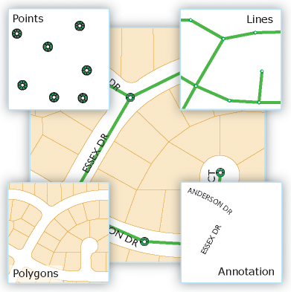
Spatial Datatypes
Currently supported spatial data types
Point
Polygon
Box
Line String
Annotation
Source : http://desktop.arcgis.com/en/arcmap/10.3/manage-data/geodatabases/feature-class-basics.htm

Slide 18
Spatial Operators
Operators :
Topology based relationships like
1. ST_INTERSECTS
Synopsis : boolean ST_Intersects( geometry geomA , geometry geomB );
2. ST_CONTAINS
Synopsis : boolean ST_Contains( geometry geomA ,geometry geomB );
3. ST_TOUCHES
Synopsis : boolean ST_Touches( geometry g1 ,geometry g2 );
Nearest neighbor operator : ST_KNN

Slide 19
Spatial Functions
Functions
Unary function --- Eg. ST_AREA
Synopsis : float ST_Area(geometry g1);
Binary function ---Eg. ST_DISTANCE
Synopsis : float ST_Distance(geometry g1, geometry g2);
Aggregate function --- Eg. ST_UNION
Synopsis : geometry ST_Union(geometry set g1field);

Slide 20
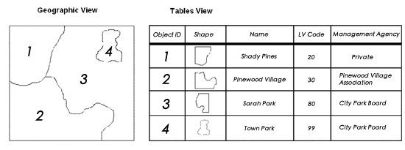
Source : http://desktop.arcgis.com/en/arcmap/10.3/manage-data/geodatabases/feature-class-basics.htm

Slide 21
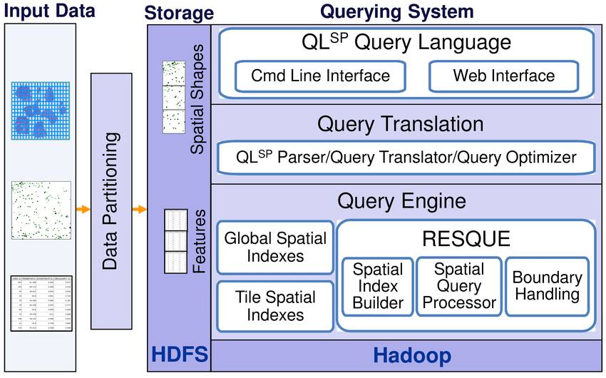
Architecture of Hadoop-GIS

Slide 22
Data Partitioning
Spatial data partitioning is an essential and initial step to define, generate and represent partitioned data
Considerations of spatial data partitioning :
Avoid high density partitioned tiles
Handle boundary interesting objects
High density partitioned tiles can be avoided by breaking high density tiles into smaller ones and Multiple assignment based approach used to handle boundary intersecting objects.

Slide 23
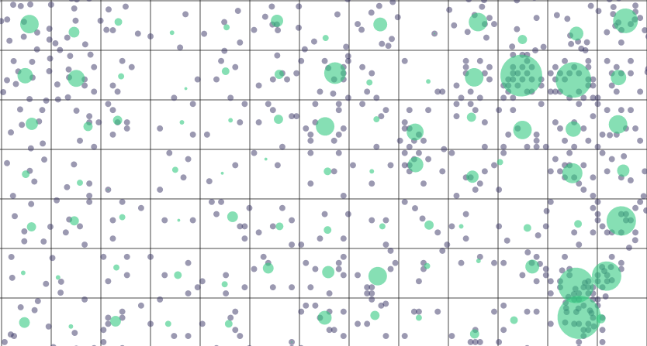
Source : https://carto.com/blog/tile-aggregation/

Slide 24
Query System
Query language :
Users interact with the system by submitting SQL queries either from a command line or web interface.
Query translation :
HiveQL Query → Abstract syntax tree → Logical plan → Operator tree

Slide 25
RESQUE
Real-time Spatial Query Engine
Standalone spatial query engine with the following requirements:
Supports variety of spatial queries
Parallelized on clusters
leverage existing indexing and query methods
RESQUE is fully optimized, supports data compression, and comes up with very low overhead of data loading.

Slide 26
RESQUE contd..
RESQUE is compiled as a shared library which can be easily deployed in a cluster environment.
Hadoop-GIS takes advantage of spatial access methods for query processing with two approaches:
Creates global region based spatial indexes of partitioned tiles for HDFS files split filtering.
Supports an indexing on demand approach by building tile based spatial indexes.

Slide 27
Boundary Object Handling
Past two approaches to handle boundary objects :
Multiple Assignment
Multiple Matching
In multiple assignment, the partitioning step replicates boundary crossing objects and assigns them to multiple tiles.
In multiple matching, partitioning step assigns as a boundary crossing object to a single tile, but the object may appear in multiple tile pairs for spatial joints.

Slide 28
Contd..
The disadvantage with Multiple matching is it could incur increase in both computation and I/O.
The multiple assignment approach is simple to implement and fits nicely with the MapReduce programming model.

Slide 29
MapReduce based parallel query execution
Implicit parallelization is used by leveraging MapReduce which simplifies the development and query management on clusters.
Tile names or UID’s forms the key for MapReduce, identifying spatial objects for tiles are performed in Mapping phase.
Depending upon query complexity, spatial queries can be implemented as map functions, reduce functions or combination of both.

Slide 30
Contd..
Based on the query types, different query pipelines are executed in MapReduce.
As many spatial queries involve high complexity geometric computations, query parallelization through MapReduce can significantly reduce query response time.

Slide 31
Integration with Hive
To support feature queries with a declarative query language, Hive is used, which provides SQL like language on top of MapReduce.
Extended Hive with spatial query support by extending HiveQL with spatial constructs, spatial query engine, spatial query translation, and execution, with integration of spatial query engine into Hive query engine.

Slide 32
3rd Part

Slide 33
Real-Time Spatial Query Engine(RESQUE)
To support “High Performance spatial Queries”:
Built Spatial Query Engine with the following capabilities:
Effective spatial access methods
Efficient spatial operators
Query pipelines
Able to run with decoupled spatial processing in a distributed computing environment.

Slide 34
General Framework of Spatial Data processing
Spatial partitioning
Data staging and global indexing in HDFS
Region based filtering based on region indexes
Foreach tile in input_region (parallel execution)
Tile based filtering based on tile indexes
Spatial Query Engine process the tiles //parallel
Post-query processing
Result is stored in HDFS

Slide 35
Multi-level Spatial Indexing
Using spatial Index to support “fast response spatial queries”:
Global Spatial Indexing for regions and tiles
On demand indexing for objects in tiles
Tests:
Show that index building time using RESQUE with R* Tree based join takes a very small fraction of the overall response time.

Slide 36
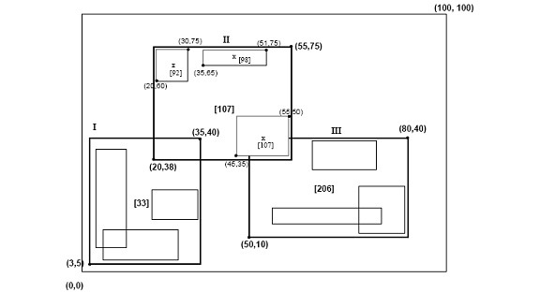
Hilbert R Tree ( Spatial Indexing )
R Tree representation

Slide 37
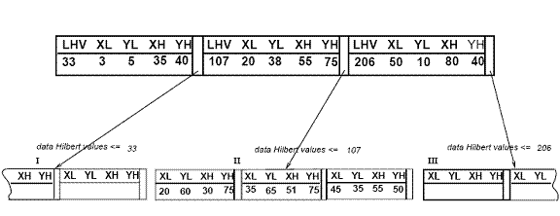
Spatial Indexing using R Tree

Slide 38
Multi-level Spatial Indexing
Global spatial Index for regions and tiles:
Facilitates region level data filtering ( Used to identify tiles)
They are small due to their large data granularity
Pre-generated and stored in HDFS
Shared across cluster nodes through Hadoop distributed cache mechanism
Dynamic Spatial index for objects in tiles:
Used for page based spatial index search.
These are built dynamically and stored in-memory
Tests show that index building on modern hardware is not a major bottleneck in large scale spatial query processing.

Slide 39
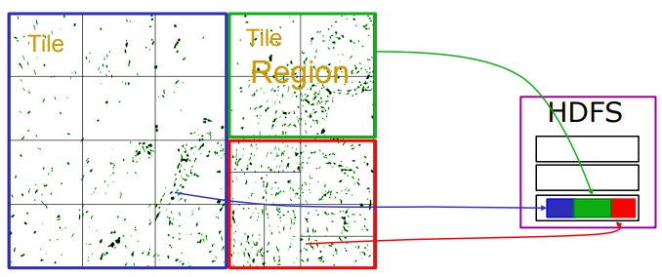
Multi-level Spatial Indexing

Slide 40
Spatial Query Workflows in RESQUE
Effective querying methods that can run in parallel in distributed computing environments .
– Spatial join, multi-way join, containment, nearest neighbor, and can be extended
Spatial Query Pipelines:
Spatial Join workflow
Spatial containment workflow
Nearest neighbour queries workflow

Slide 41
Spatial Join Workflow
Where two datasets in a tile are “joined” to find intersecting polygon objects:
Building bulk spatial Index for each dataset ( R* Tree)
R* Tree files are stored in-memory
Contains MBR’s in interior nodes
Contains polygon objects in the leaf node
Filtering on MBR
Refinement on polygon pairs
Measurement on intersected polygon pairs
Ex: Overlap area ratio

Slide 42
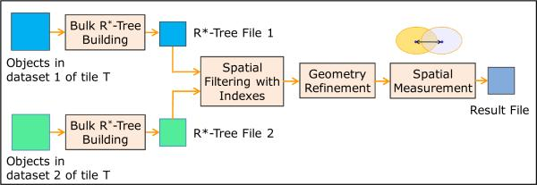
Spatial Join Workflow

Slide 43
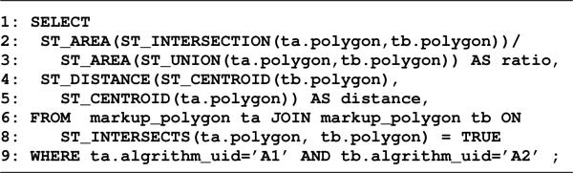
Spatial Join Workflow

Slide 44
Spatial Join Workflow
Index Optimization:
Bulk – loading techniques are used
To minimize number of pages - page utilization ratio is set to 100%
Using compression to reduce leaf node shape sizes
Compact chain code based representation
Simple Chain code compression approach can save 40% space for pathology imaging use case

Slide 45
Spatial Join Workflow
Spatial Refinement and Measurement:
For each pair of mark-up polygons whose MBR’s intersect – precise geometric computation algorithm ( is used to validate Intersection)
Spatial Refinement cost > query execution cost
this could be accelerated through GPU based approach ( In future work)

Slide 46
Spatial Containment Workflow
Query range may span only a single tile or multiple tiles.
Step1: Identify list of intersecting tiles ( using Global spatial Index tree)
Step2: the tiles whose MBRs intersect with the query range will then be further processed ( using single dynamic index )
Examples:
Given a small shape – find whether it lies in the tile.
Given a point – find the containing objects in the tile.

Slide 47
Nearest Neighbor Query
An example query for a pathologist is “for each cell, return nearest blood vessels and the distances”.
Spatial access methods are widely used to support point NN queries
They provided two algorithms for efficient nearest neighbor query support.
NN Search with R*-Tree
Voronoi Diagram

Slide 48
NN Search with R* Tree
Tile based partitioning is not applicable in this case:
After such partition NN of one object may reside in other tile- So if they are processed independently we may not get correct result
Multiple ways to solve this:
Process query in multiple passes
Index building process is initiated
Partial indexes from above are merged and replicated across nodes
Each node gather enough information to answer the query
Source objects are partitioned and target objects are replicated

Slide 49
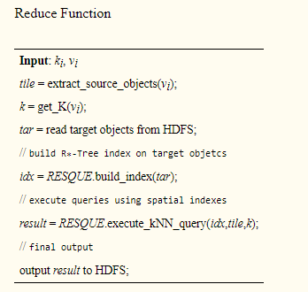
NN Search with R* Tree:

Slide 50
4th Part

Slide 51
MAPREDUCE BASED SPATIAL QUERY PROCESSING
RESQUE provides a core query engine to
support spatial queries which enables us to
develop high performance large scale spatial query processing based on MapReduce Framework.

Slide 52
Our Approach is based on
1)Spatial Data Partitioning
2)Tile based spatial query processing with
MapReduce
3)Normalization for tile Boundary Objects.

Slide 53
SPATIAL DATA PARTITIONING AND STORAGE
Purpose of Spatial Data Partitioning
1)Two Dimensional Data Partitioning
2)Generates set of Tiles
Which become a processing unit for querying
Tasks.

Slide 54
3)Spatial Partitioning provides computational
Parallelization.
4)Could be helpful to mitigate spatial data
Skew.

Slide 55
Data Skew
Data skew primarily refers to a non uniform distribution in a dataset.
The direct impact of data skew on parallel execution of complex database queries is a poor load balancing leading to high response time.

Slide 56
If there is a parallel spatial query processing based on tiles such large skewed tile could significantly increase the response time due to the straggling tiles.

Slide 57
So, in-order to balance the tasks we provide Map-Reduce for Spatial Data Partitioning.
By recursive partitioning approach it balances the tasks

Slide 58
Assumptions made before Partitioning
Pre-Partitioned tile set with fixed grid size , which is useful for imaging analysis
Or
Pre-Generate fixed grid based tile set if no
Partition exists

Slide 59
C-max threshold as the maximal count of objects allowed in a tile.
This process is repeated until all tiles have counts below than C-max.

Slide 60
After partitioning, each object in a tile is assigned a corresponding tile UID(Unique
Identity)
The MBR (Master Boot Record)( data of Partitioned tiles) of tiles are
maintained in a global spatial index.

Slide 61
Each dataset of a different type will have its own separate partitioning.
Partitioning is considered together for all these datasets based on combined object count

Slide 62
Large number of small files leads to deteriorated performance for MapReduce due to
1)First, each file block consumes certain amount of main memory on the cluster name-node and this directly compromises cluster scalability and disaster recoverability.
2)Second, in the Map phase, the large number of blocks for small files leads to “large number of small map tasks” which has significant task-startup overhead.

Slide 63
For objects across tile boundaries, we take the multiple assignment approach, such boundary objects may participate in multiple query tasks which could lead to incorrect query results.
Therefore, the query results are normalized through an additional boundary handling process in which results are rectified . While this method will incur redundancy on object storage, the ratio of boundary objects is usually small

Slide 64
Spatial Join with MapReduce
As spatial join is the most commonly used and costly queries, we discuss how to map spatial join queries into MapReduce computing model.
An example spatial join query for spatial cross-matching in SQL. This query finds all intersecting polygon pairs between two result sets generated from an image by two different methods, and compute the overlap ratios (intersection-to-union ratios) and centroid distances of the pairs.

Slide 65
Example spatial join (cross-matching) query
SELECT
ST_AREA(ST_INTERSECTION(ta.polygon, tb.polygon))/
ST_AREA(ST_UNION(ta.polygon, tb.polygon)) AS ratio,
ST_DISTANCE(ST_CENTROID(tb.polygon),
ST_CENTROID(ta.polygon)) AS distance,
FROM markup_polygon ta JOIN markup_polygon tb ON
ST_INTERSECTS(ta.polygon, tb.polygon) = TRUE
WHERE ta.algrithm_uid=’A1’ AND tb.algrithm_uid=’A2’

Slide 66
A MapReduce program for spatial join query will have similar structure as a regular relational join operation
But with all the spatial part executed by invoking RESQUE engine within the program.

Slide 67
The program has three main steps
i) Map Phase: The input table is scanned and the WHERE condition is evaluated on each record. Only those records that satisfy the WHERE condition are emitted with tile uid is as key.
ii) Shuffle Phase: All records with the same tile uid would be sorted and prepared for the reducer operation.
iii) Reduce Phase : The tile based spatial join operation is performed on the input records and the spatial operations are executed by invoking the RESQUE engine

Slide 68
Work Flow of Map Function
function Map(k , v):
tile uid = projectKey(v);
join seq = projectJoinSequence(v);
record = projectRecord(v);
v = concat(join seq,record);
emit( tile uid , v);
Each record in the table is converted into the map function input key/value pair (k, v), where k is the byte offset of the line in the file, and v is the record.

Slide 69
Work Flow of Reduce Function
function JoinReduce(k,v):
join set = [ ] ; /* arraylist holds join objects */
for vi in v do
join seq = projectJoinSequence(vi);
record = projectRecord(vi);
if join seq == 0 then
join set[0].append(record);
if join seq == 1 then
join set[1].append(record);
plan = RESQUE.genLocalPlan(join set); /* library call to RESQUE */
result = RESQUE.processQuery(plan);
for item in result do
emit(item);

Slide 70
Other Spatial Query Types
WorkFlow of Spatial Query Processing
Data/space partitioning;
Data storage of partitioned data on HDFS;
Pre-query processing (optional);
for tile in input collection do
Index building for objects in the tile;
Tile based spatial querying processing;
Boundary object handling;
Post-query processing (optional);
Data aggregation;
Result storage on HDFS;

Slide 71
Spatial selection/containment is a simple query type in which objects geometrically contained in selection region are returned.
Query to retrieve cancerous cells:
SELECT * FROM markup_polygon m, human_markup h
WHERE h.name=’cancer’ AND
ST_CONTAINS(h.region, m.polygon) = TRUE;

Slide 72
Since data is partitioned into tiles, containment queries can be processed in a filter-and-refine fashion.
Filter step: Tiles which are disjoined from the query region can be filtered.
Refinement step: The candidate objects are checked with precise geometry test

Slide 73
5th Part

